Slide 1
Country Risk Analysis
16
Chapter
South-Western/Thomson Learning © 2003

Slide 2
Chapter Objectives
To identify the common factors used by MNCs to measure a country’s political risk and financial risk;
To explain the techniques used to measure country risk; and
To explain how the assessment of country risk is used by MNCs when making financial decisions.

Slide 3

Country Risk Analysis
Country risk represents the potentially adverse impact of a country’s environment on the MNC’s cash flows.

Slide 4
Country Risk Analysis
Country risk can be used:
  to monitor countries where the MNC is presently doing business;
  as a screening device to avoid conducting business in countries with excessive risk; and
  to improve the analysis used in making long-term investment or financing decisions.

Slide 5

Political Risk Factors
Attitude of Consumers in the Host Country
  Some consumers may be very loyal to homemade products.
Attitude of Host Government
  The host government may impose special requirements or taxes, restrict fund transfers, subsidize local firms, or fail to enforce copyright laws.

Slide 6
Political Risk Factors
Blockage of Fund Transfers
  Funds that are blocked may not be optimally used.
Currency Inconvertibility
  The MNC parent may need to exchange earnings for goods.

Slide 7
Political Risk Factors
War
  Internal and external battles, or even the threat of war, can have devastating effects.
Bureaucracy
  Bureaucracy can complicate businesses.
Corruption
  Corruption can increase the cost of conducting business or reduce revenue.

Slide 8
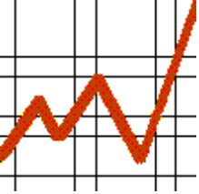
Financial Risk Factors
Current and Potential State of the Country’s Economy
  A recession can severely reduce demand.
  Financial distress can also cause the government to restrict MNC operations.
Indicators of Economic Growth
  A country’s economic growth is dependent on several financial factors - interest rates, exchange rates, inflation, etc.

Slide 9
Types of Country Risk Assessment
A macro-assessment of country risk is an overall risk assessment of a country without consideration of the MNC’s business.
A micro-assessment of country risk is the risk assessment of a country as related to the MNC’s type of business.

Slide 10
Types of Country Risk Assessment
The overall assessment of country risk thus consists of :
  Macro-political risk
  Macro-financial risk
  Micro-political risk
  Micro-financial risk

Slide 11
Types of Country Risk Assessment
Note that the opinions of different risk assessors often differ due to subjectivities in:
  identifying the relevant political and financial factors,
  determining the relative importance of each factor, and
  predicting the values of factors that cannot be measured objectively.

Slide 12
Techniques of
Assessing Country Risk
A checklist approach involves rating and weighting all the identified factors, and then consolidating the rates and weights to produce an overall assessment.
The Delphi technique involves collecting various independent opinions and then averaging and measuring the dispersion of those opinions.

Slide 13
Techniques of
Assessing Country Risk
Quantitative analysis techniques like regression analysis can be applied to historical data to assess the sensitivity of a business to various risk factors.
Inspection visits involve traveling to a country and meeting with government officials, firm executives, and/or consumers to clarify uncertainties.

Slide 14
Techniques of
Assessing Country Risk
Often, firms use a variety of techniques for making country risk assessments.
For example, they may use a checklist approach to develop an overall country risk rating, and some of the other techniques to assign ratings to the factors considered.

Slide 15
Developing A Country Risk Rating
A checklist approach will require the following steps:
  Assign values and weights to the political risk factors.
  Multiply the factor values with their respective weights, and sum up to give the political risk rating.
  Derive the financial risk rating similarly.

Slide 16
Developing A Country Risk Rating
A checklist approach will require the following steps:
  Assign weights to the political and financial ratings according to their perceived importance.
  Multiply the ratings with their respective weights, and sum up to give the overall country risk rating.

Slide 17
Developing A Country Risk Rating
Different country risk assessors have their own individual procedures for quantifying country risk.
Although most procedures involve rating and weighting individual risk factors, the number, type, rating, and weighting of the factors will vary with the country being assessed, as well as the type of corporate operations being planned.

Slide 18
Developing A Country Risk Rating
Firms may use country risk ratings when screening potential projects, or when monitoring existing projects.
For example, decisions regarding subsidiary expansion, fund transfers to the parent, and sources of financing, can all be affected by changes in the country risk rating.

Slide 19
Comparing Risk Ratings
Among Countries
One approach to comparing political and financial ratings among countries is the foreign investment risk matrix (FIRM ).
The matrix measures financial (or economic) risk on one axis and political risk on the other axis.
Each country can be positioned on the matrix based on its political and financial ratings.

Slide 20
Actual Country Risk Ratings Across Countries
Some countries are rated higher according to some risk factors, but lower according to others.
On the whole, industrialized countries tend to be rated highly, while emerging countries tend to have lower risk ratings.
Country risk ratings change over time in response to changes in the risk factors.

Slide 21
Incorporating Country Risk in Capital Budgeting
If the risk rating of a country is in the acceptable zone, the projects related to that country deserve further consideration.
Country risk can be incorporated into the capital budgeting analysis of a project
  by adjusting the discount rate, or
  by adjusting the estimated cash flows.

Slide 22
Incorporating Country Risk in Capital Budgeting
Adjustment of the Discount Rate
  The higher the perceived risk, the higher the discount rate that should be applied to the project’s cash flows.
Adjustment of the Estimated Cash Flows
  By estimating how the cash flows could be affected by each form of risk, the MNC can determine the probability distribution of the net present value of the project.

Slide 23
Applications of
Country Risk Analysis
Alerted by its risk assessor, Gulf Oil planned to deal with the loss of Iranian oil, and was able to avoid major losses when the Shah of Iran fell four months later.
However, while the risk assessment of a country can be useful, it cannot always detect upcoming crises.

Slide 24
Applications of
Country Risk Analysis
Iraq’s invasion of Kuwait was difficult to forecast, for example. Nevertheless, many MNCs promptly reassessed their exposure to country risk and revised their operations.
The 1997-98 Asian crisis also showed that MNCs had underestimated the potential financial problems that could occur in the high-growth Asian countries.

Slide 25
Reducing Exposure to Host Government Takeovers
The benefits of DFI can be offset by country risk, the most severe of which is a host government takeover.
To reduce the chance of a takeover by the host government, firms often use the following strategies:
Use a Short-Term Horizon
  This technique concentrates on recovering cash flow quickly.

Slide 26
Reducing Exposure to Host Government Takeovers
Rely on Unique Supplies or Technology
  In this way, the host government will not be able to take over and operate the subsidiary successfully.
Hire Local Labor
  The local employees can apply pressure on their government.

Slide 27
Reducing Exposure to Host Government Takeovers
Borrow Local Funds
  The local banks can apply pressure on their government.
Purchase Insurance
  Investment guarantee programs offered by the home country, host country, or an international agency insure to some extent various forms of country risk.

Slide 28
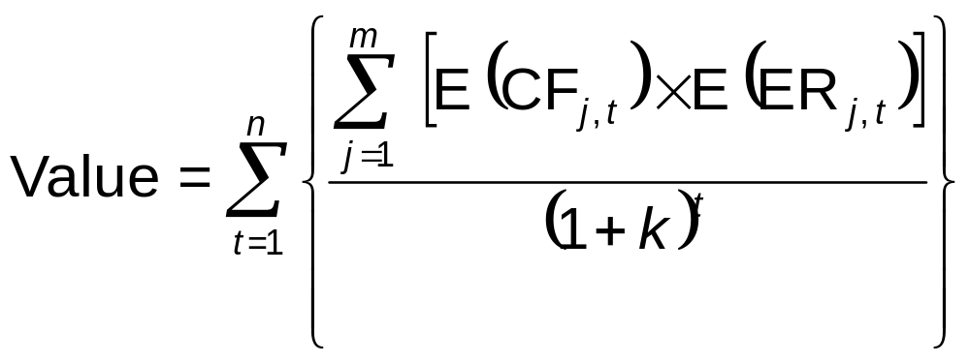
Impact of Country Risk on an MNC’s Value
Exposure of Foreign Projects to Country Risks
E (CF_{j,t} ) = expected cash flows in currency j to be received by the U.S. parent at the end of period t
E (ER_{j,t} ) = expected exchange rate at which currency j can be converted to dollars at the end of period t
k = weighted average cost of capital of the parent

Slide 29
Chapter Review
Why Country Risk Analysis Is Important
Political Risk Factors
  Attitude of Consumers in the Host Country
  Attitude of Host Government
  Blockage of Fund Transfers
  Currency Inconvertibility
  War
  Bureaucracy
  Corruption

Slide 30
Chapter Review
Financial Risk Factors
  Current and Potential State of the Country’s Economy
  Indicators of Economic Growth
Types of Country Risk Assessment
  Macro-Assessment of Country Risk
  Micro-Assessment of Country Risk

Slide 31
Chapter Review
Techniques of Assessing Country Risk
  Checklist Approach
  Delphi Technique
  Quantitative Analysis
  Inspection Visits
  Combination of Techniques

Slide 32
Chapter Review
Developing a Country Risk Rating
  Example of Measuring Country Risk
  Variation in Methods of Measuring Country Risk
  Using the Country Risk Rating for Decision-Making
Comparing Risk Ratings Among Countries
Actual Country Risk Ratings Across Countries

Slide 33
Chapter Review
Incorporating Country Risk in Capital Budgeting
  Adjustment of the Discount Rate
  Adjustment of the Estimated Cash Flows
Applications of Country Risk Analysis

Slide 34
Chapter Review
Reducing Exposure to Host Government Takeovers
  Use a Short-Term Horizon
  Rely on Unique Supplies or Technology
  Hire Local Labor
  Borrow Local Funds
  Purchase Insurance
Impact of Country Risk on an MNC’s Value

